Slide 1
Y variable

Slide 2
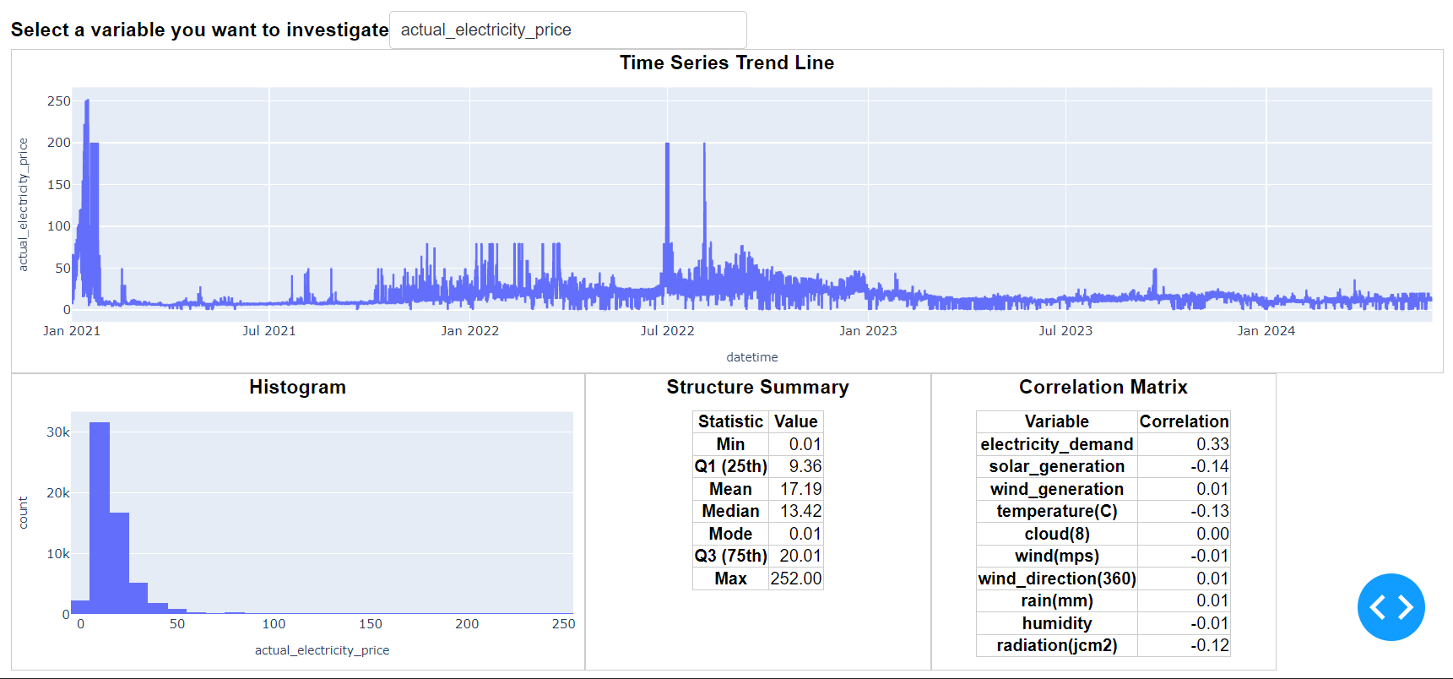
Y variable, actual electricity price, is relatively stable. It doesn't show some seasonal movement. But it does have outliers during 2021 Q1 and 2022 Q3.

Slide 3
X variables highly correlated to Y variable

Slide 4
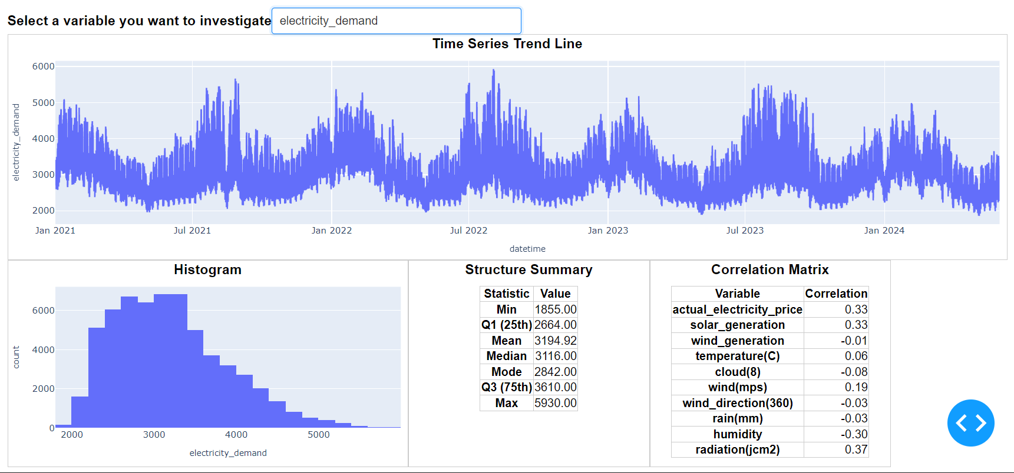

Slide 5
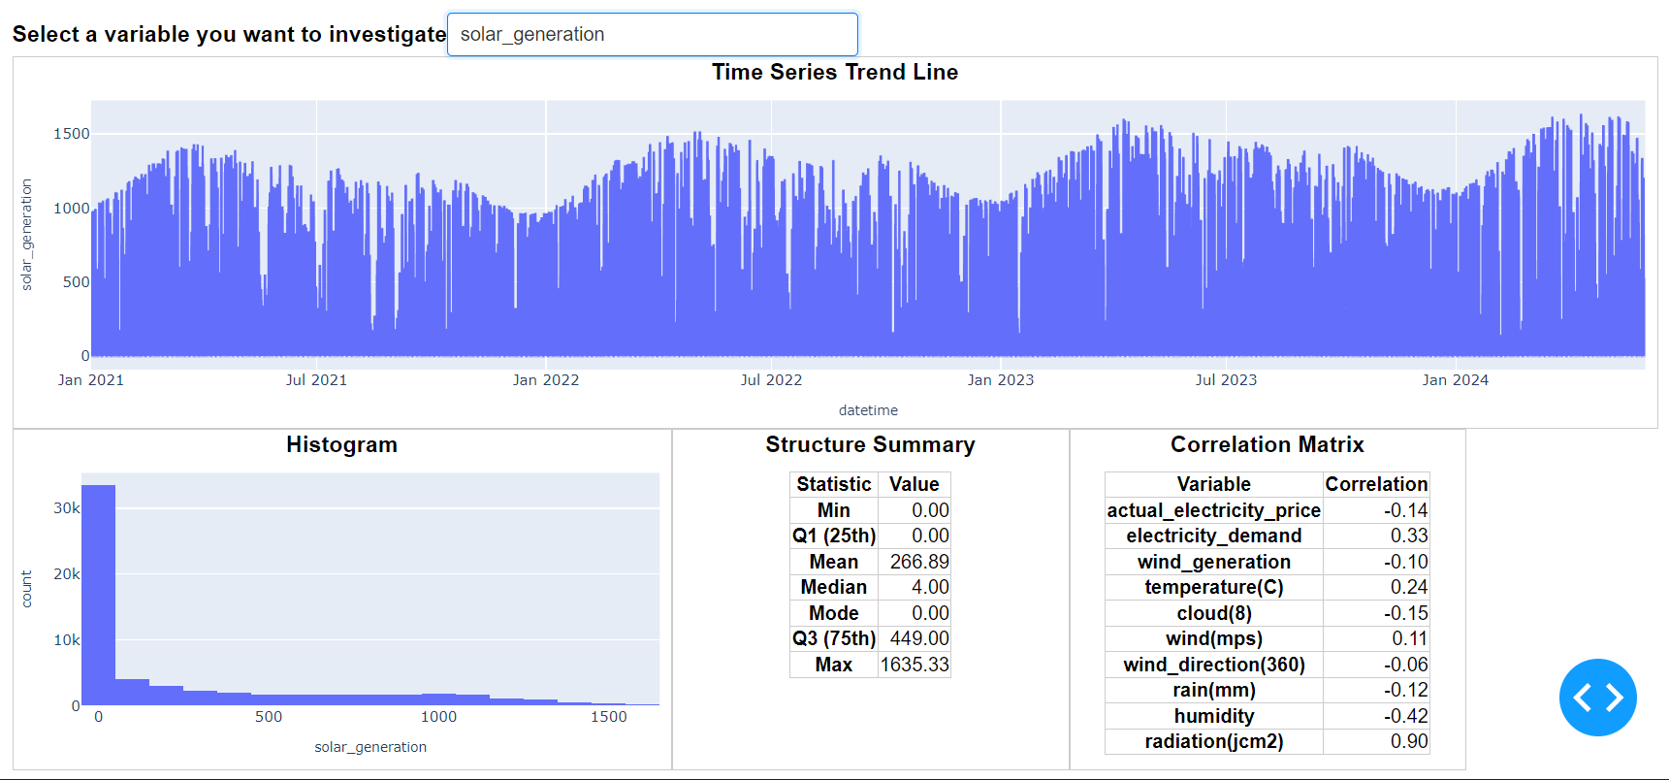

Slide 6
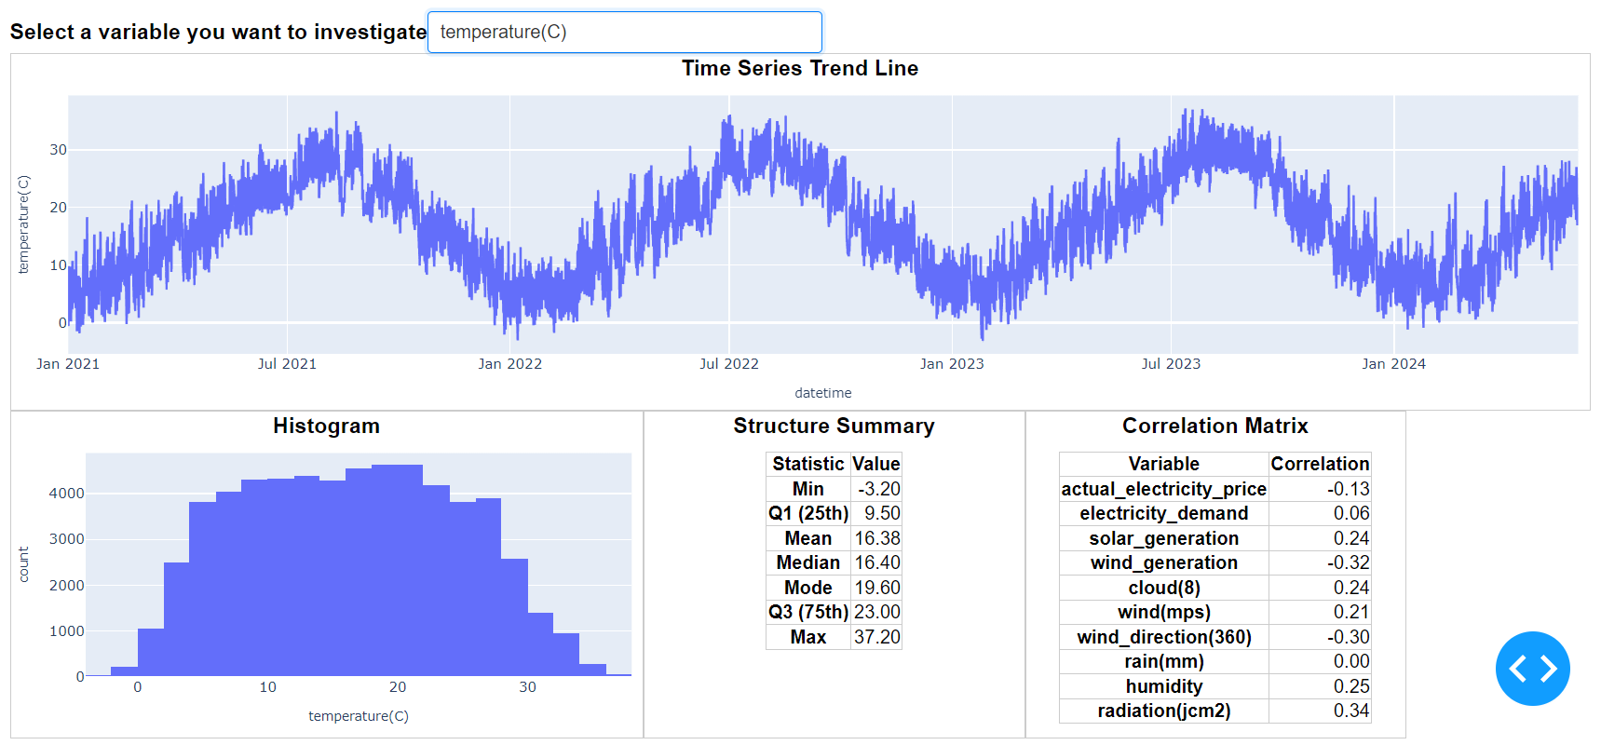

Slide 7
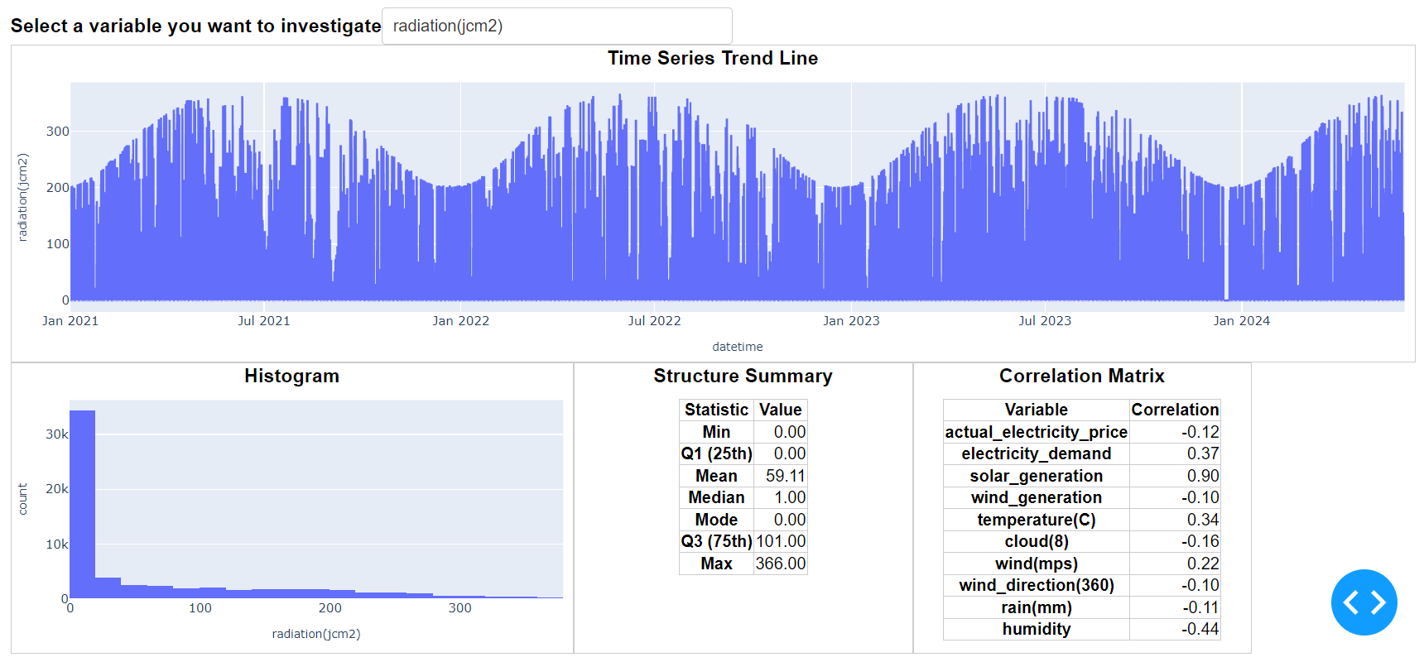

Slide 8
Other X variables

Slide 9
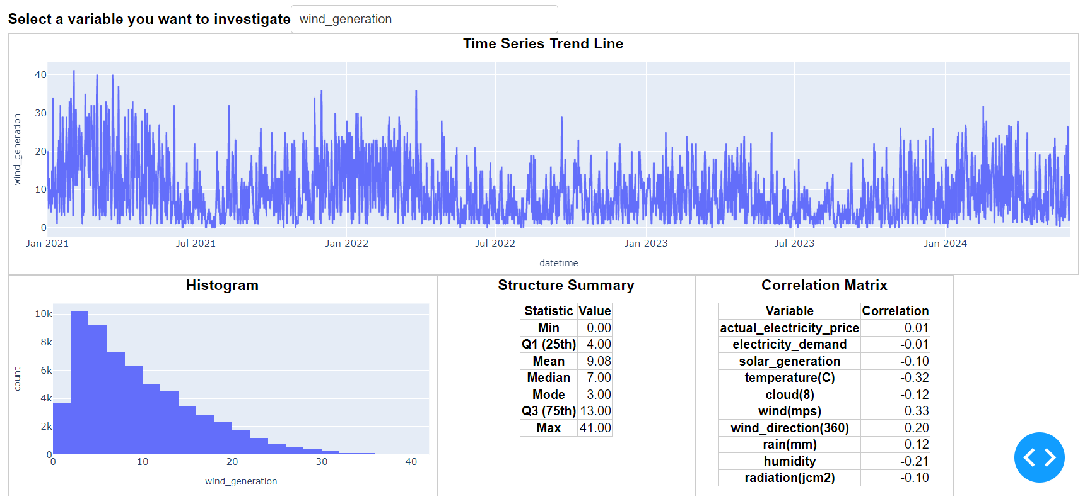

Slide 10
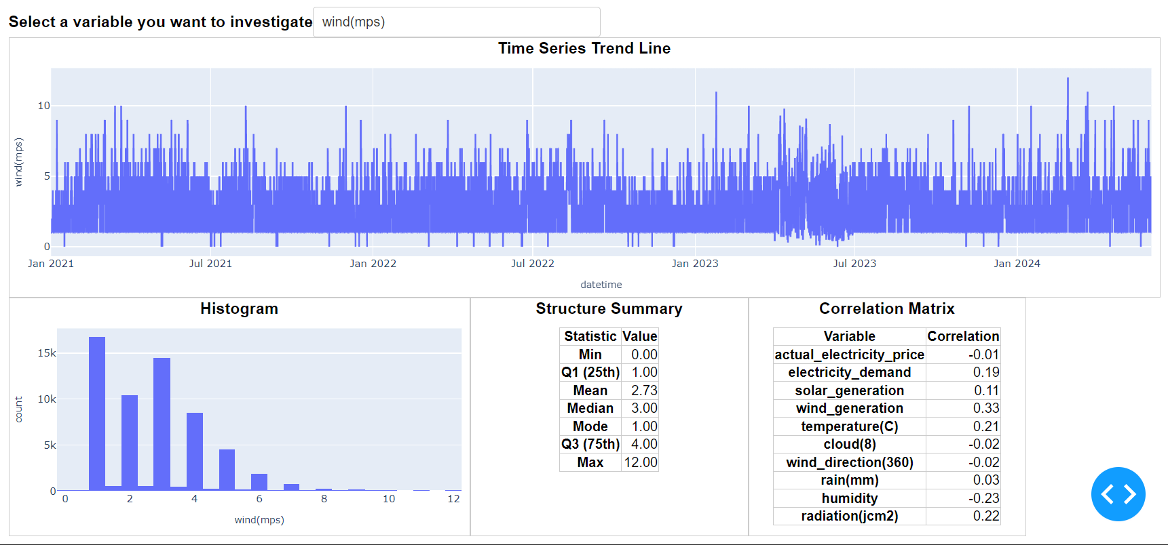

Slide 11
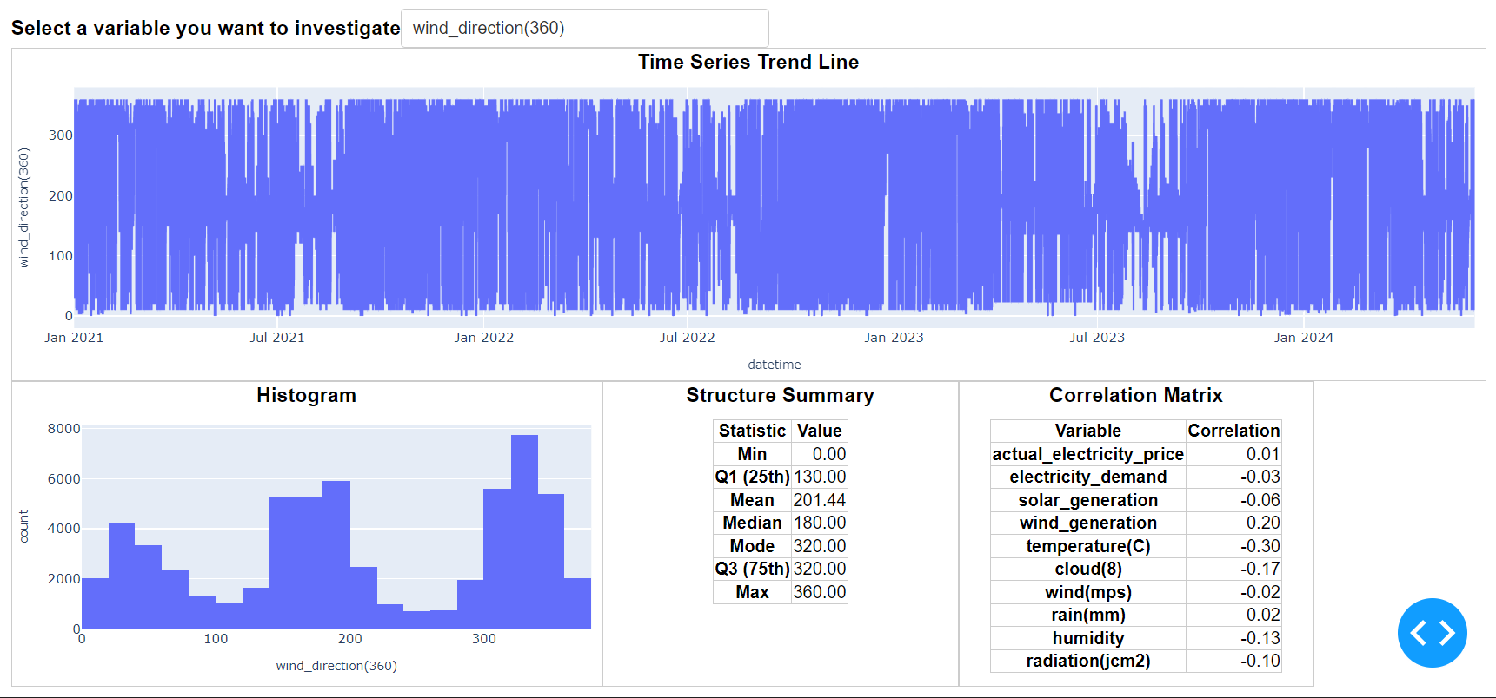

Slide 12
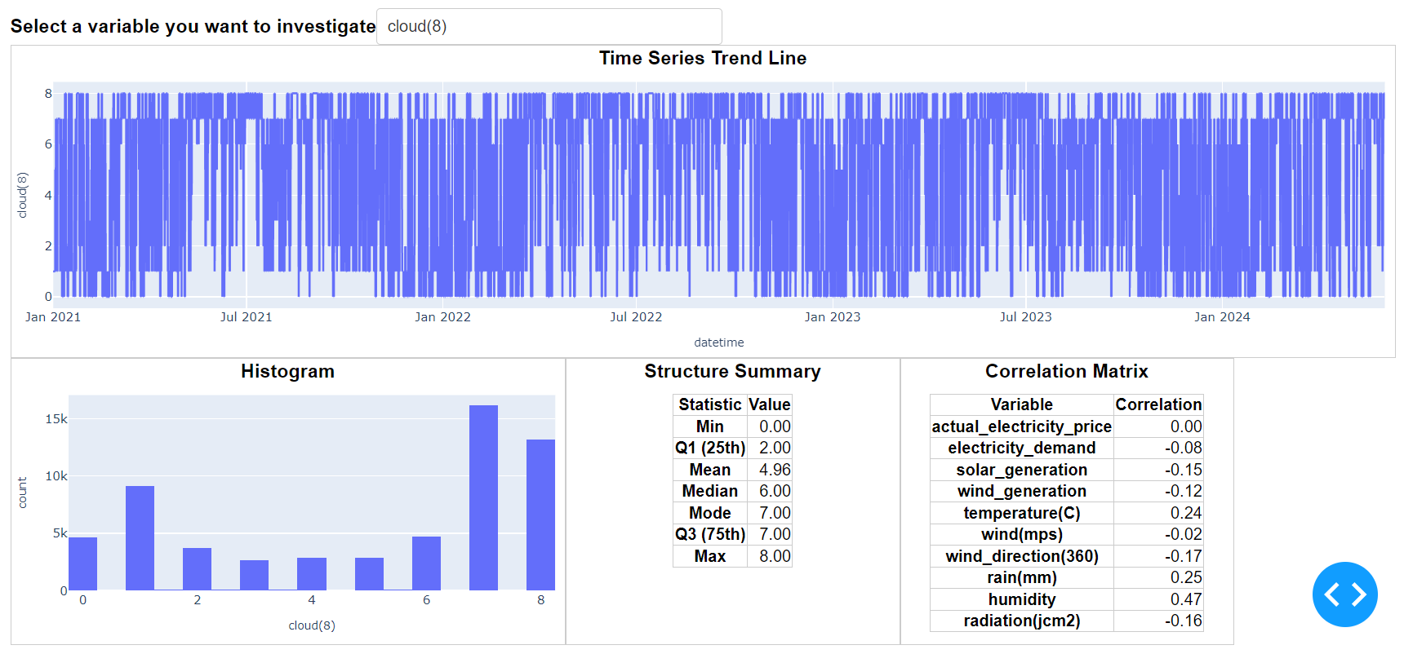

Slide 13
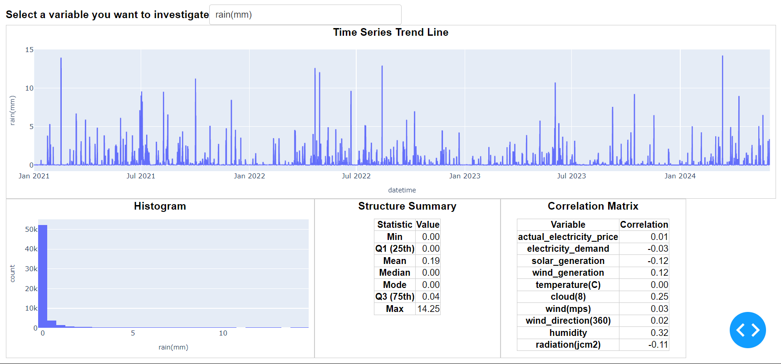

Slide 14
